Slide 1
Parallel Adders
A circuit, consisting of n full adders, that will add n-bit binary numbers.
The output consists of n sum bits and a carry bit.
C_{OUT} of one full adder is connected to C_{IN} of the next full adder.

Slide 2
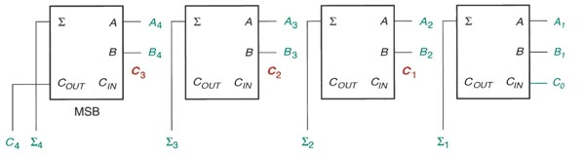
Parallel Adders

Slide 3
Parallel Binary Adders

Slide 4
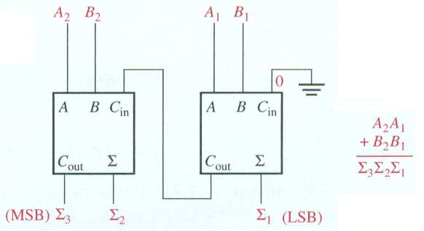
Parallel Binary Adders
Two-bit parallel binary adder

Slide 5
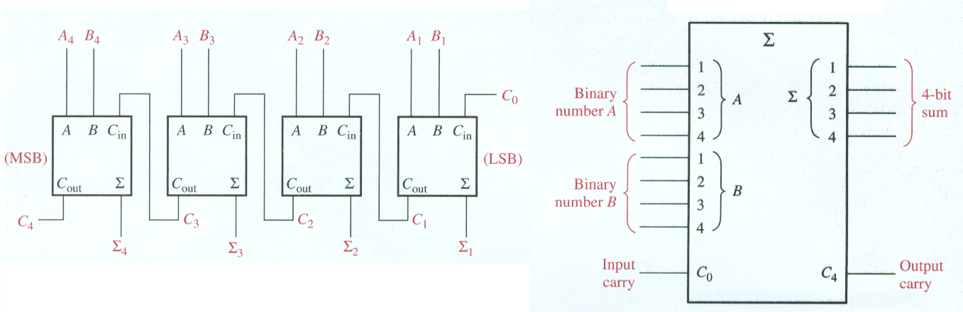
Parallel Binary Adders
Four-bit parallel binary adder

Slide 6
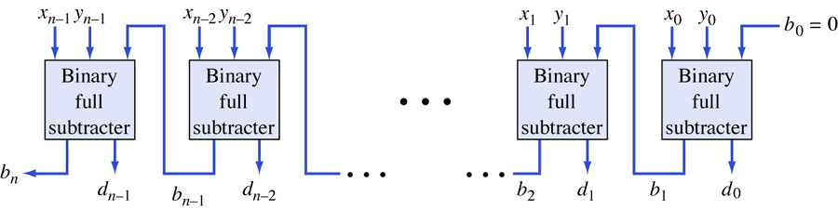
Parallel Binary Subtractor
Parallel (ripple) binary subtractor
1/2550
A. Yaicharoen

Slide 7
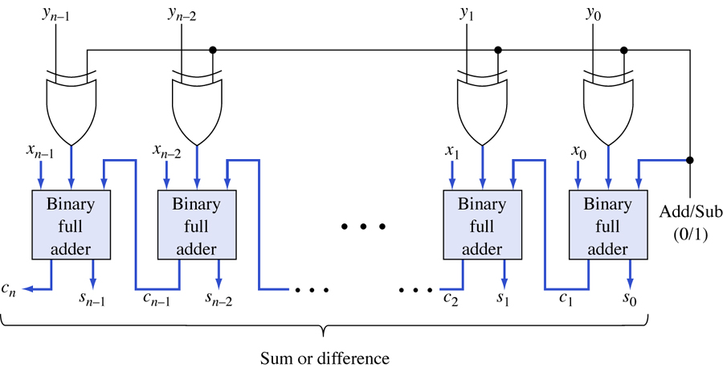
Parallel Binary Adder/Subtractor
1/2550
A. Yaicharoen

